Slide 1
MILK PRODUCTION Forecasting
Proof Of Concept and
Minimum Viable Product

Slide 2
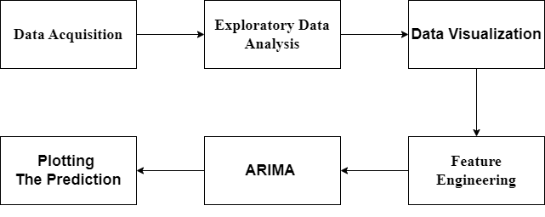
Proof of concept Minimum viable product

